Slide 1
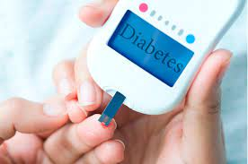
"Diabetes Dataset Analysis"
By:
Rushabh Gaikwad

Slide 2
Table of content
Introduction
Objectives
Work Flow
Tools and Algorithms used for project
Data Description
Data Preprocessing
Data Visualization
Data Partition
Model Train and Test Accuracy
Challenges in the Project
Conclusion
Future Scope

Slide 3
Introduction
According to the report of Centers of Disease Control and Prevention about one in seven adults in the United States have Diabetes.
"Our goal is to analyze and gain insights from this dataset to better understand the factors associated with diabetes.“
"Diabetes is a prevalent and serious health concern, and understanding the data can help us make informed decisions and interventions.“
The dataset encompasses information such as pregnancies, glucose levels, blood pressure, skin thickness, insulin levels, body mass index (BMI), diabetes pedigree function, and age.

Slide 4
Objectives
To develop predictive models that can estimate an individual's risk of developing diabetes based on their health-related parameters, such as glucose levels, BMI, and age.
To identify the most influential factors (features) that contribute to the occurrence of diabetes. This could help in better understanding the disease's underlying causes.
To assess and address data quality issues, such as missing values, outliers, or inconsistencies in the dataset.
To uncover patterns, trends, and relationships within the dataset, which could provide valuable insights into the prevalence of diabetes and potential risk factors.

Slide 5
WORK FLOW
Data Collection
Data import
Data Preprocessing
Collecting dataset from the clever programmer
Imported data using pandas package
Manipulating data wherever needed
Data Visualization
Select best model
Checking Accuracy
Model Building
Different graphs and charts to explain data pattern
Decing the best model based on accuracies
Comparing accuracies of all the models
Build 4 models
Logistic,Decision,Random, KNN & Boosting

Slide 6
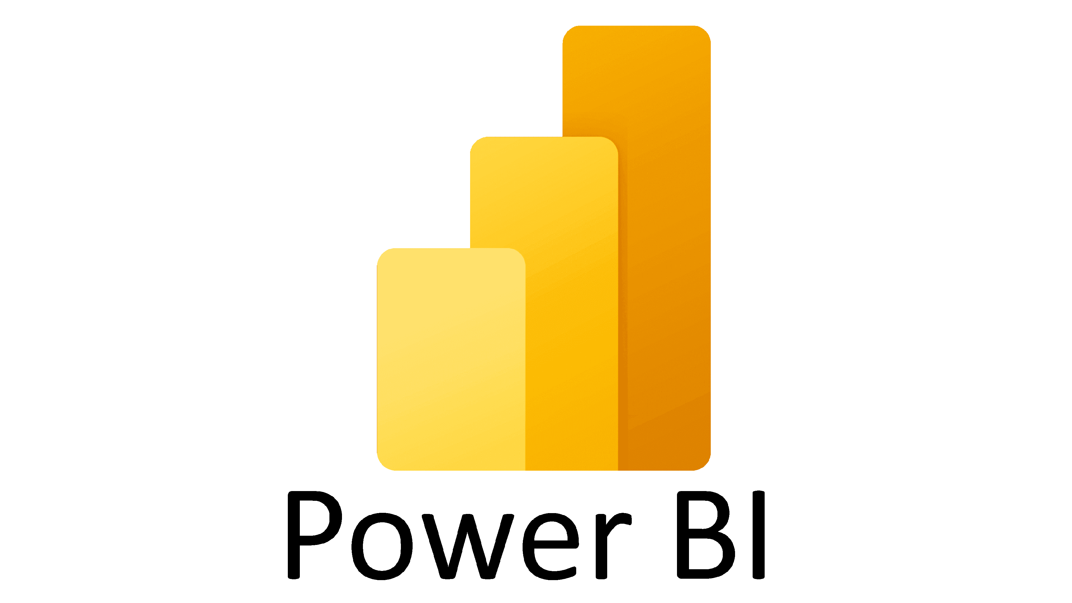



Tools and algorithms used for project
Using platform: Jupiter notebook
Tools: Python Language, Power BI
Python Packages:
Pandas and NumPy for data analysis and calculation.
Matplot, Seaborn, Plotly for data Visualization.
Statsmodel and Sklearn for Machine learning.
Machine learning Algorithms:
Logistic Regression, Decision Tree, Random forest, Gradient Boosting,
KNN.

Slide 7
Data Description
Variable Description and Identification:
We can see total 9 variables, and each variables has 768 observations. Here comes the description of all variables:
Pregnancies, Glucose, Blood Pressure, SkinThickness, Insulin,
BMI , DiabetesPedigreeFunction, Age, Outcome.

Slide 8
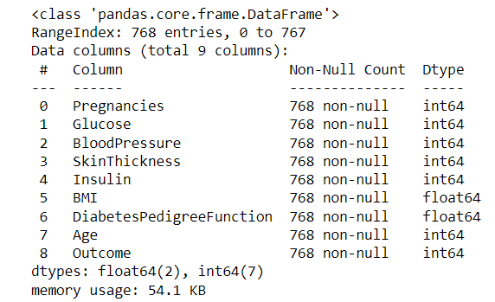
EXPLORATORY DATA ANALYSIS
1. Data Type
Here we have 768 rows
and 9 columns in data.
In data we have data type of
float and integer.

Slide 9
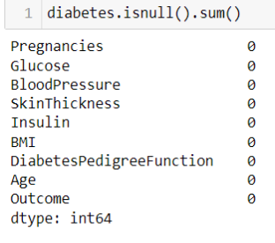
2. Identifying & Treatment of Missing value
Here we checked for missing values, we do not have missing values in our data

Slide 10
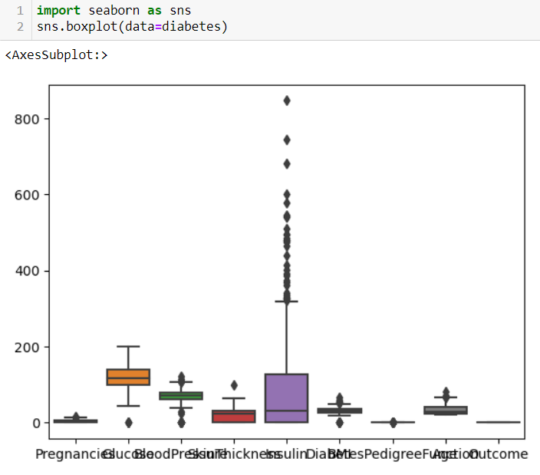
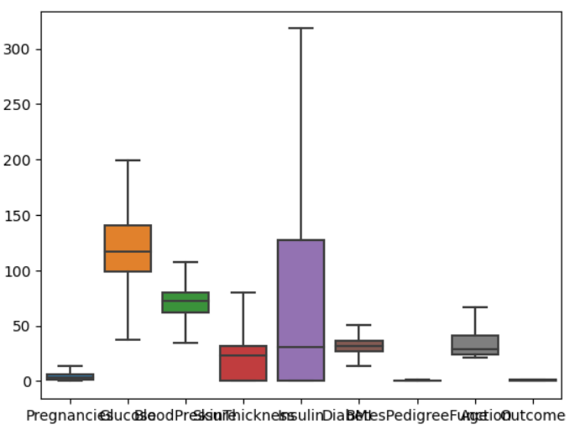
3. Treatment of outliers
Here we checked outliers, there is outliers in data and we Treat outliers Using Winsorizing Technique.

Slide 11
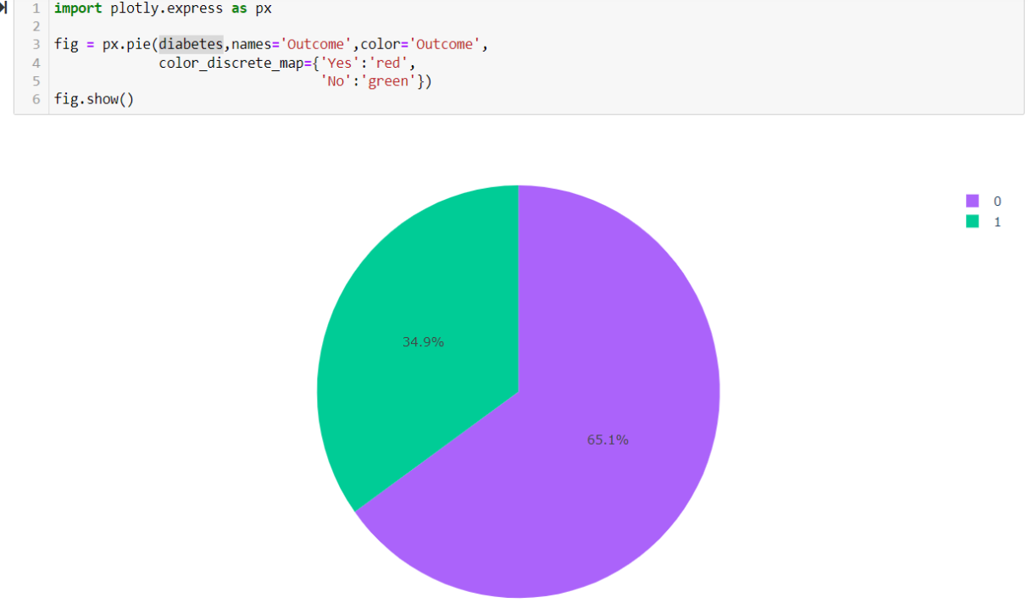
4. Pie Chart
“Outcome” is the feature we are going to predict, 0 means No diabetes, 1 means diabetes.

Slide 12
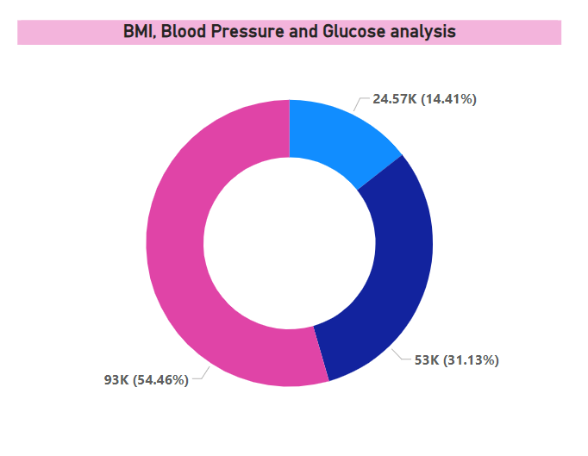
DATA VISUALIZATION
Donut Chart

Slide 13
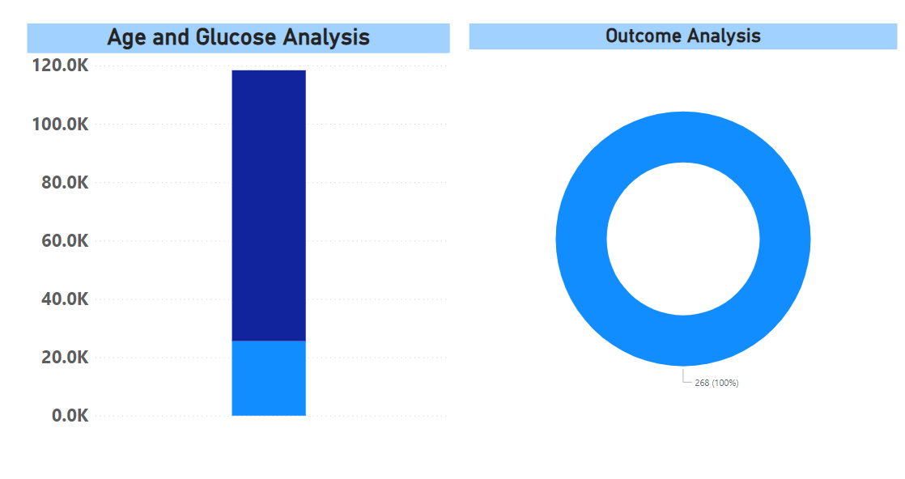
Donut Chart
Bar Chart
Donut Chart

Slide 14
Data Partition
Train-test split
Train dataset(70%)
Test dataset(30%)
Dataset
The data partition is done using train_test_split from sklearn library.
70% data is kept in train, whereas 30% is used for test.

Slide 15
Model train and test accuracy
We performed various machine learning models in this dataset.
As the accuracy of Random Forest model is satisfactory for both train and test data, we chose results of that model to present.
the evaluation method is used for the project is confusion matrix.

Slide 16
Models | Train Accuracy | Test Accuracy
Logistic Regression | 76 | 77
KNeighbors | 72 | 76
DecisionTree | 69 | 75
Random Forest | 75 | 84
Gradient Boosting | 73 | 99

Slide 17
Challenges in the project
Dealing with missing values.
Identify and treatment outliers.
Dealing with hyper tuning parameters was one of the most challenging task.
Dealing with over fitting and under fitting model accuracy.
And the last but the least was selecting the best model among the all models.

Slide 18
conclusion
Glucose levels and BMI appear to be significant predictors of diabetes. Higher glucose levels and elevated BMI are associated with an increased risk of diabetes, underscoring the importance of monitoring and managing these parameters.
The dataset shows varying levels of insulin and skin thickness. While insulin levels are positively associated with diabetes risk, skin thickness may not be a strong predictor. Further investigation is required to understand their contributions fully.
Age and the number of pregnancies also play a role in diabetes risk. Older individuals and those with a higher number of pregnancies tend to have a higher likelihood of diabetes.
The dataset emphasizes the potential role of genetic factors, as indicated by the diabetes pedigree function, in determining diabetes risk. A family history of diabetes can significantly impact an individual's susceptibility.

Slide 19
Future scope
Continue refining and enhancing machine learning models for diabetes prediction. Consider using more advanced algorithms and incorporating additional relevant features..
Explore the genetic aspects of diabetes by incorporating genetic data. Investigate specific genetic markers associated with diabetes risk.
Conduct a longitudinal study to track individuals over time, allowing for a better understanding of how health parameters change and contribute to diabetes development.
Incorporate data related to lifestyle and behavior, such as physical activity, dietary habits, and stress levels, to better understand their roles in diabetes development.

Slide 20
Thank you

